Slide 1



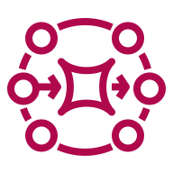




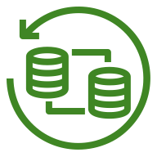



Trust Framework
Allows users to share offline anonymous verifiable credentials, proving service entitlement without disclosing PII nor entitlement reasons. 3rd parties (3Ps) can verify credential’s authenticity (offline or in real-time) using the issuer’s public key. 3Ps can also verify credential ownership anonymously using users’ face hash, and can collect user’s preferences (KYC). PII is only stored in vaults, and any user info is shared only with direct or indirect trusted 3Ps, and only on user’s approval.
1
Wallet apps are the user interfaces (UI) of the trust framework. They generate a key pair and a face hash, and keep the private key from ever living the device. Wallets rely on graphs to translate info codes.
Concierges act as wallet backends. They store users, user vaults, and user verifiable credentials, and they offload from wallets the handshake between 3Ps and vaults.
Vaults are user’s distributed databases, storing preferences and verifiable credentials. They share user’s info with 3Ps on user approval. Vaults use listeners to notify graphs of key rotations, and use graphs to find a trust chain to the 3P.
3rd Parties (3P) are service providers. On user check-in, 3Ps ask users’ concierge for info and credentials. 3Ps use graphs to find a trust chain to the vault and to get the vault’s public key to verify credentials.
Closed circuits are physical areas that use the “verified” 3P-generated stickers to simplify user’s check-point verification. They use graphs to cache vault’s public keys, allowing offline sticker-verification.
Verifiers are physical devices that scan “verified” 3P-generated stickers to verify user’s entitlement to services. They also use graphs to cache vault’s public keys, allowing offline sticker-verification.
Authorities either define the codes that categorize the info shared between 3Ps and vaults, or they contribute to trust chains by stating who they trust, or both.
Graphs map the trust chains between vaults and 3Ps using authority’s trusts.
Listeners help graphs to be up-to-date.
2
manifest updated
3
3
trust?
events
Users
bind
Vaults
Cloud Proxies
webhook
4
1
8
9
translate
webhook
Wallets & Notifiers
Graphs
Listeners
5
Graphs
export
export
5
6
2
Brokers
Closed Circuits
Verifiers
push
6
4
trust vault?
fetch
Consumers
7
Domains
7
manifest updated
8
9

